Slide 1


Cleaning Renewable Energy Systems in Nigeria
ENGR 2050 - Introduction to Engineering Design
Prof. Semih Akin and Glen R Gross
Nathan Anthony, Fanta Cisse, Kismet Crossdale, Kamsi Dozie-Obele, Hayden Fuller, Jameson Giannattasio
Milestone 1 - Problem Definition Presentation
Notes:
Kismet

Slide 2
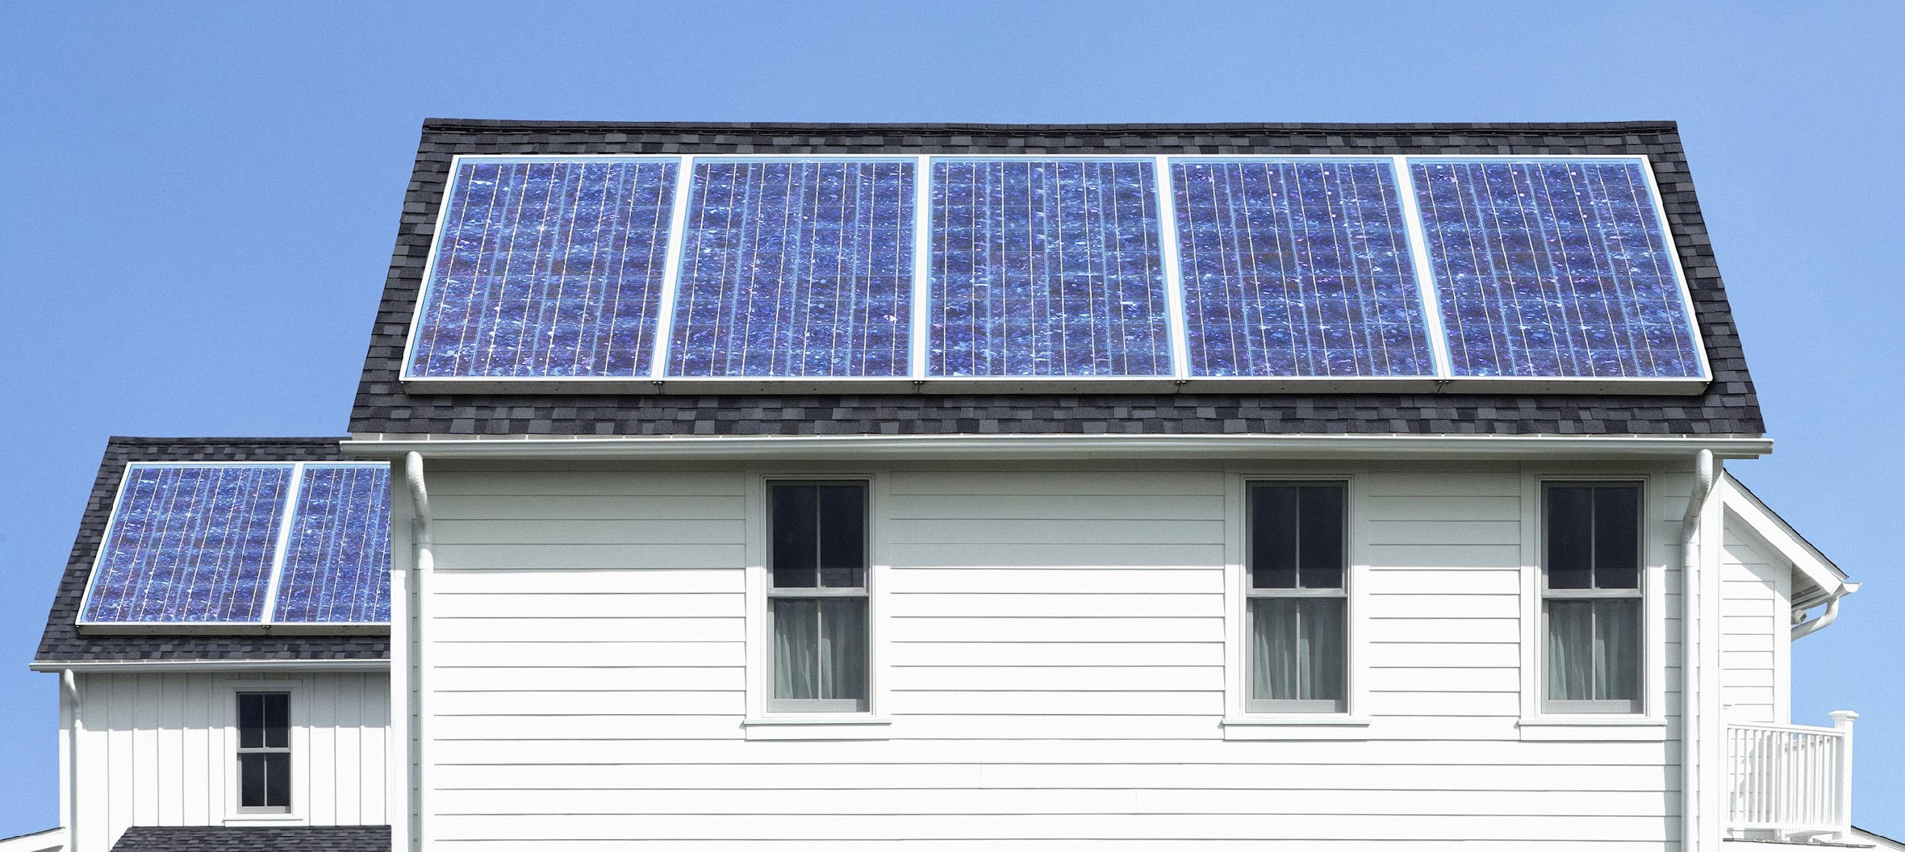
Agenda
Problem Identification
User IDs & Needs
User Statements
Professional & Societal Factors + DEI
Problem Statement
Design Specifications
Planning
Team Development & Standards Agreement
Stock Image
Notes:
Kismet

Slide 3

Problem Identification
What is the problem?
A significant portion of Nigeria is unable to access stable energy.
What is the scope of the problem?
47% of Nigeria’s 213.4 million population (approx. 100.3 million) [1]
Explain why the problem is a problem (symptoms)
Citizens don't have consistent light
Affects agriculture and food production
Communication and medical equipment outages
Lack of heat & air conditioning
After 10 years, solar panel efficiency drops [5]
Why is the present state not sufficient? (What is the unsatisfactory state?)
Frequent power outages
Negatively affects businesses/economy
Solar panel maintenance costs keep people from utilizing solar
Notes:
The problem we’ll be looking at today is reliable energy in Nigeria, where only about half the population has access to grid electricity, and even those that do, experience constant power outages.
This creates several issues. Citizens don’t have lighting or HVAC, communication and medical equipment is unavailable for extended periods of time, and industry and economy comes to a standstill.
Solar is one proposed solution to maintain power while the grid is unavailable and to reduce strain on the grid while it is, but currently, solar adoption is slow due to long term maintenance and cleaning costs.
https://www.worldbank.org/en/news/press-release/2021/02/05/nigeria-to-improve-electricity-access-and-services-to-citizens#:~:text=85%20million%20Nigerians%20don't,access%20deficit%20in%20the%20world.
Hayden

Slide 4

Problem Identification (Cont.)
Why is there a need for innovation and improvement?
Ensure consistent source of power
Cost can be minimized by minimizing maintenance
Dust on solar panels can cause shorts limiting the lifetime of the device
A cheap method to clean debris of solar panels can make solar more affordable
What are the negative outcomes of the problem?
Annual losses estimated at $26.2 billion [1]
What could be the impact of a successful intervention?
Increased lifetime of solar panels
More reliable energy availability
More production in day-to-day life
Significant economic impact
Makes it easier and cheaper to have solar panels (more of an incentive)
A cheap method to clean debris of solar panels can make these devices more affordable
Stock Image
Notes:
Hayden
Currently, these issues cause an estimated economic loss of 26.2 billion dollars annually.
By making solar maintenance more affordable and convenient, we can increase the rate of solar adoption,
which will give people more reliable access to energy, allow the economy to operate at it’s full capacity, and improve the lives of millions.
One issue we plan to pursue:
Dust deposited on solar panels can cause shorts in the solar cells leading to a decrease in the lifetime of the device. Dust and debris is removed normally through rainfall but due to a lack of rainfall and an increase of dust in the air during the dry season, we are looking for a low cost automatic cleaning addon to solar panels to improve the lifetime of these devices during the dry season
Hayden

Slide 5
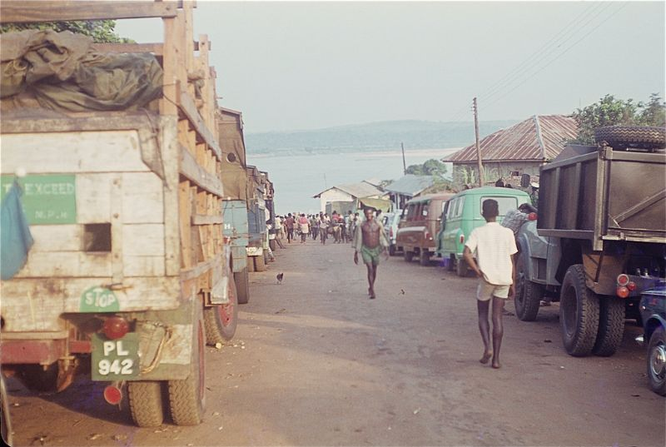
User IDs & Needs
User IDs
Low/middle class families in Nigeria
Stakeholders:
Nigerian Government
Nigerian Energy Support Program
Environmental NGOs
User Needs
Low cost - 1.25% of people in Nigeria use solar panels due to the high cost
Simple to install and maintain
Provide more energy due to removing debris that decreases power output of solar panels by 7% - 50% [3].
Increase lifetime and reliability of solar panels so that families can use them for longer (especially with constant and frequent blackouts)
Current cleaning costs (based on US data [9]): 268,950 - 564,795 Nigerian Naira ($300 to $630 USD) per year
[6]
Notes:
https://atlantickeyenergy.com/how-effective-are-dirty-solar-panels/
https://www.nrel.gov/news/features/2021/scientists-studying-solar-try-solving-a-dusty-problem.html
https://tradingeconomics.com/country-list/consumer-price-index-cpi
Nigeria has a Consumer Price Index of about 2 times the US, essentially making solar twice as expensive
https://www.homeadvisor.com/cost/cleaning-services/solar-panel-maintenance/
When accounting for Consumer Price Index differences, this is equivalent to $600 to $1260
Kamsi

Slide 6
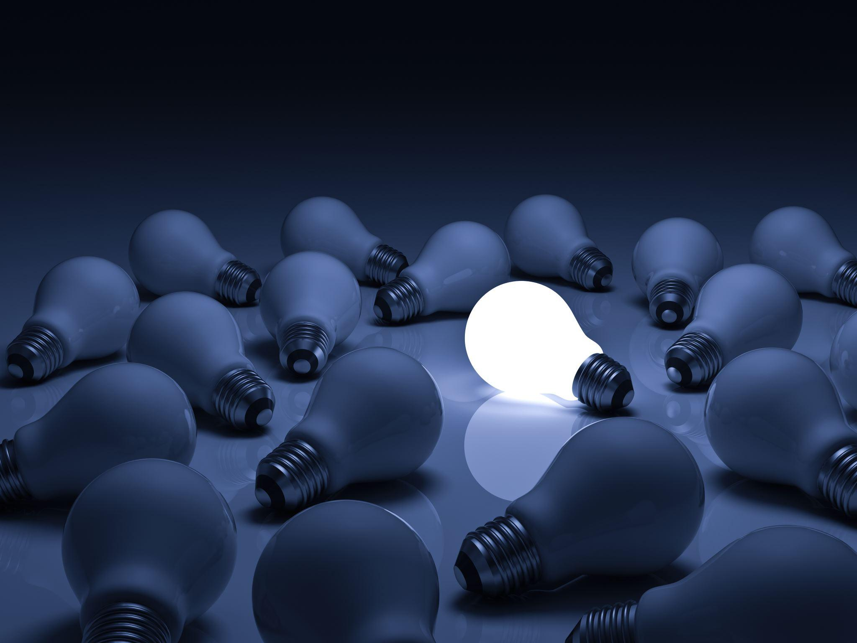
User Statements
49 out of 50 users experience blackouts in Nigeria.
45 out of 50 users, who affected by blackouts, have their daily lives interrupted.
35 out of 50 users expressed that if the maintenance and cleaning costs were lower, they would install solar panels.
Stock Image
Notes:
Fanta

Slide 7
Professional & Societal Factors + DEI
Potential users: Local communities which include families, especially families and people who require stable electricity to cook, clean, and need air conditioning.
Societal Factors:
Affordability
Accessibility- Not everybody has the physical accessibility of electricity services, some people live further out than others in the country which makes accessibility to the power source harder
Professional Factors:
Infrastructure: The condition and availability of the electrical grid, transmission lines impact the electricity provided to local communities
The framework of the power sector (licensing, pricing and quality control) affect the power provided
Financial resources: The amount of funding and amount invested into it can affect the quality of the power provided
Notes:
Kamsi

Slide 8

Problem Statement
General Statement: Almost half of Nigeria’s population does not have access to stable, well-functioning power. The goal of this project is to design a product to reduce the time & labor of cleaning a solar panel in the absence of rain.
Unsatisfactory State & Symptoms:
Unstable Power & Electricity in Nigeria
Inability to use Internet, Hot Running Water, Household Appliances
Spending Tons of Money on Power Sources (i.e. Solar Panels) just for them to be an Inconvenience
Impact of Successful Solution:
Unleashing Nigeria’s True Economic Potential
Increase Access to Advanced Technologies
Everyday Life Becomes Easier
Understanding Users/Stakeholder Landscape:
Nigerian Families/Household
Low/Middle Class Incomes
Defining Success:
Increase in Percentage of people with access to well-functioning electricity/power
Innovation Opportunities:
Decrease cost of Solar Panels
Self-cleaning Solar Panels
Shading Mitigation
Nanostructured Surfaces
Notes:
Fanta

Slide 9
Design Specifications for Debris Cleaning Solution
User Need | Metric | Target | Reason
Affordability | Cost of product | Less than $100 USD | Most families able to afford it
Easy to install | Time of installation | Can install within 30 minutes | No outside sources required for installing
Energy | Energy output | Energy output stays above 90% | Consistent source of energy
Longevity | Lifetime of solar panels | Lifetime increases by 10 years | Don’t need to replace panels nearly as often
Notes:
Jameson

Slide 10
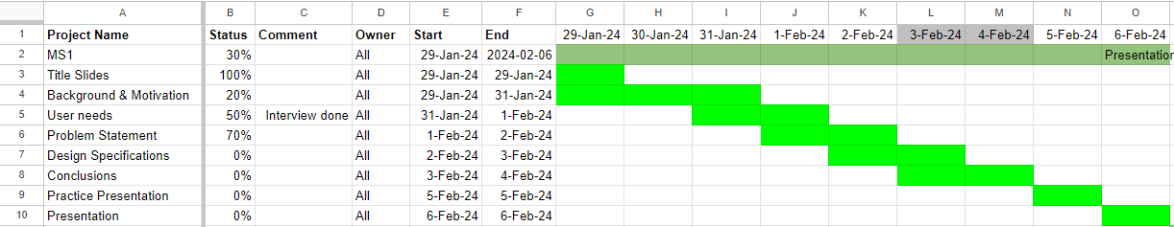
Planning
Phase 1/ MS 1:
Each step takes at least 2 – 3 days to complete
Dividing work between team members is essential
Have each part done by the assigned deadline makes completion much faster
Notes:
Kismet

Slide 11
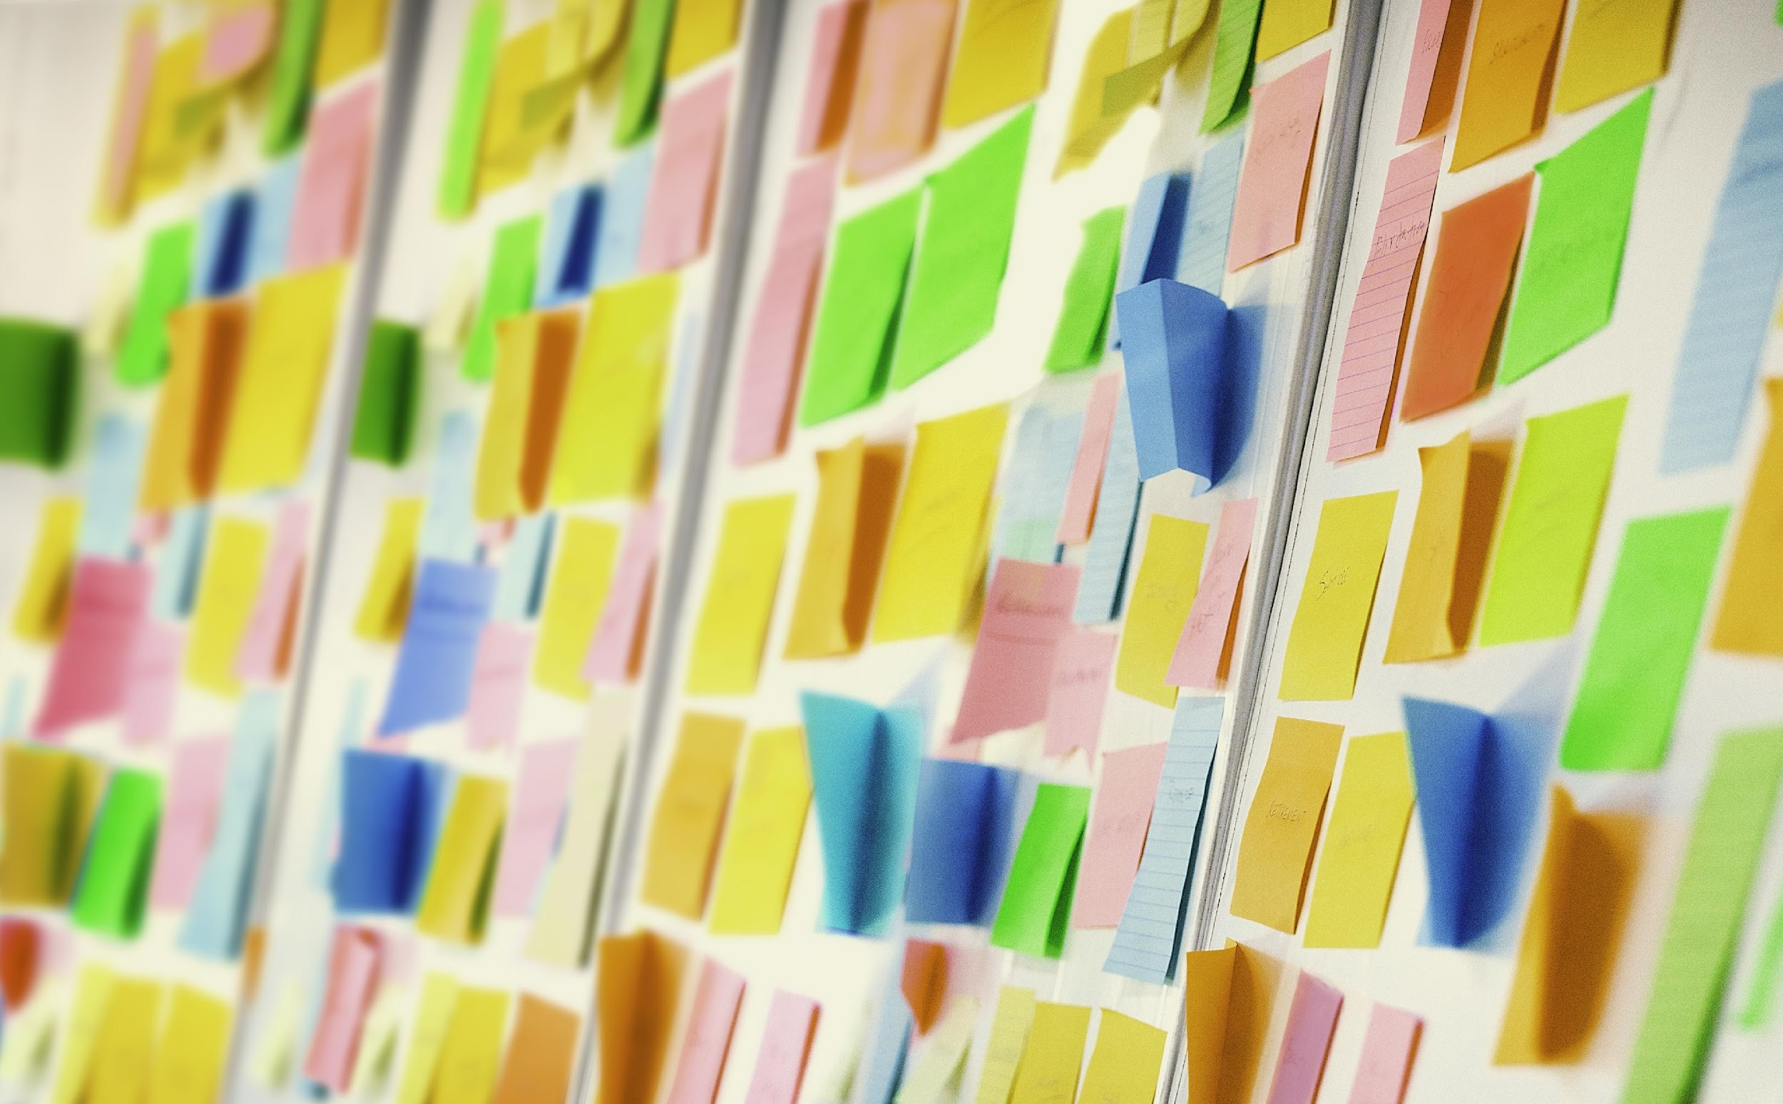
Planning (Cont.)
Looking forward to Phase 2:
Continue to:
Use tools like Gantt Chart & Critical Path diagram
Assign certain members with tasks
Stock Image
Notes:
Kismet

Slide 12

Team Development & Standards Agreement
Ground Rules
Respect (not speaking over each other, don’t edit each other’s work)
People are expected to hold themselves accountable and communicate what they need
Conflict Resolution
Aim to make decisions as the result of discussion during meetings
If a team member becomes a problem, some confrontation would be made to address that persons concerns and needs as well as the concerns and needs of the team
Notes:
Decisions will be made through thoughtful group discussion by coming to a consensus on a given issue
Rationale: Group voting can alienate certain members of the group by possibly making them feel unheard.
An agenda will be discussed in class before each meeting. Meetings will be held tentatively on Mondays at 6 pm as needed to accomplish work for the class. Thursdays at 6 pm may be used as a backup date.
Rationale: Stay on topic, complete everything efficiently
There will be weekly check-ins during meetings. During every meeting, we go around the table and check in on how everyone is doing (progress-wise/mentally/physically, etc.)
Rationale: School is important, but mental and physical health = top priority

Slide 13

Team Development & Standards Agreement (Cont.)
Meeting Organization
Agenda made in class before meetings
Someone designated to take meeting minutes
Someone designated to keep people on track
Opportunity to check in and make sure people are hanging in there
Finances
Necessary purchases will be charged to everyone evenly at the end of the semester
Discussed keeping cost to a minimum
Notes:
To meet the current organizational needs of the team, the roles of secretary and meeting facilitator have been established for the duration of the class.
Rationale: Clear distinction of roles, stay on topic, keep record of meetings
Finances = managed by secretary in spreadsheet & purchases with no receipt aren’t compensated/recorded
Rationale: keep record of purchases, ensuring compensation is accurate
Intervention
Rationale: keep group members accountable in respectful manner to ensure group efficiency

Slide 14
Citations (IEEE)
[1] “Nigeria to Improve Electricity Access and Services to Citizens” World Bank. Accessed January 31, 2024. [Online]. Available: https://www.worldbank.org/en/news/press-release/2021/02/05/nigeria-to-improve-electricity-access-and-services-to-citizens#:~:text=85%20million%20Nigerians%20don't,access%20deficit%20in%20the%20world
[2] “How Effective Are Dirty Solar Panels” Atlantic Key Energy. Accesses January 31, 2024. [Online]. Available https://atlantickeyenergy.com/how-effective-are-dirty-solar-panels/
[3] “Scientists Studying Solar Try Solving A Dusty Problem” National Renewable Energy Laboratory. Accessed January 31, 2024. [Online]. Available https://www.nrel.gov/news/features/2021/scientists-studying-solar-try-solving-a-dusty-problem.html
[4] “Nigeria Fuel Subsidy Solar Climate” AP News. Accessed January 31, 2024. [Online]. Available:https://apnews.com/article/nigeria-fuel-subsidy-solar-climate-9b3f32283b0f2fab9f6096761ef815e7
[5] “Solar Panel Degradation And The Lifespan of Solar Panels” Paradise Solar Energy. Accessed February 02, 2024. [Online]. Available:https://www.paradisesolarenergy.com/blog/solar-panel-degradation-and-the-lifespan-of-solar-panels#
[6] "51 Color Photos That Capture Everyday Life of Nigeria in the 1960s" Vintage News Daily. Accessed February 03, 2024. [Online). Available: https://vintagenewsdaily.com/51-color-photos-that-capture-everyday-life-of-nigeria-in-the-1960s/
[7] “Scientists Studying Solar Try Solving A Dusty Problem” National Renewable Laboratory. Accessed February 02, 2024. [Online]. Available: https://www.nrel.gov/news/features/2021/scientists-studying-solar-try-solving-a-dusty-problem.html
[8] “Consumer Price Index CPI” Trading Economics. Accessed February 02, 2024. [Online]. Available: https://tradingeconomics.com/country-list/consumer-price-index-cpi
[9] “Solar Panel Maintenance” Home Advisor. Accessed February 02, 2024. [Online]. Available: https://www.homeadvisor.com/cost/cleaning-services/solar-panel-maintenance/

